Slide 1
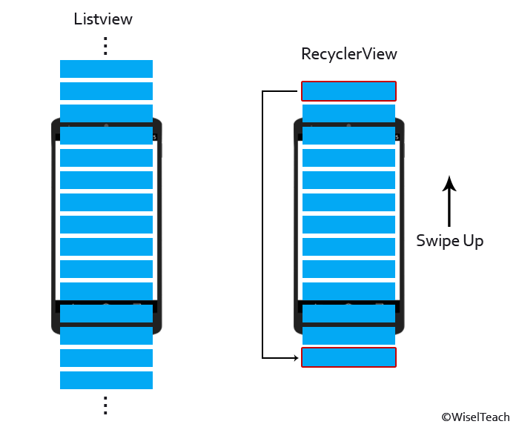
Using LazyColumn for long lists
LazyColumn
Manual list of composables

